Slide 1
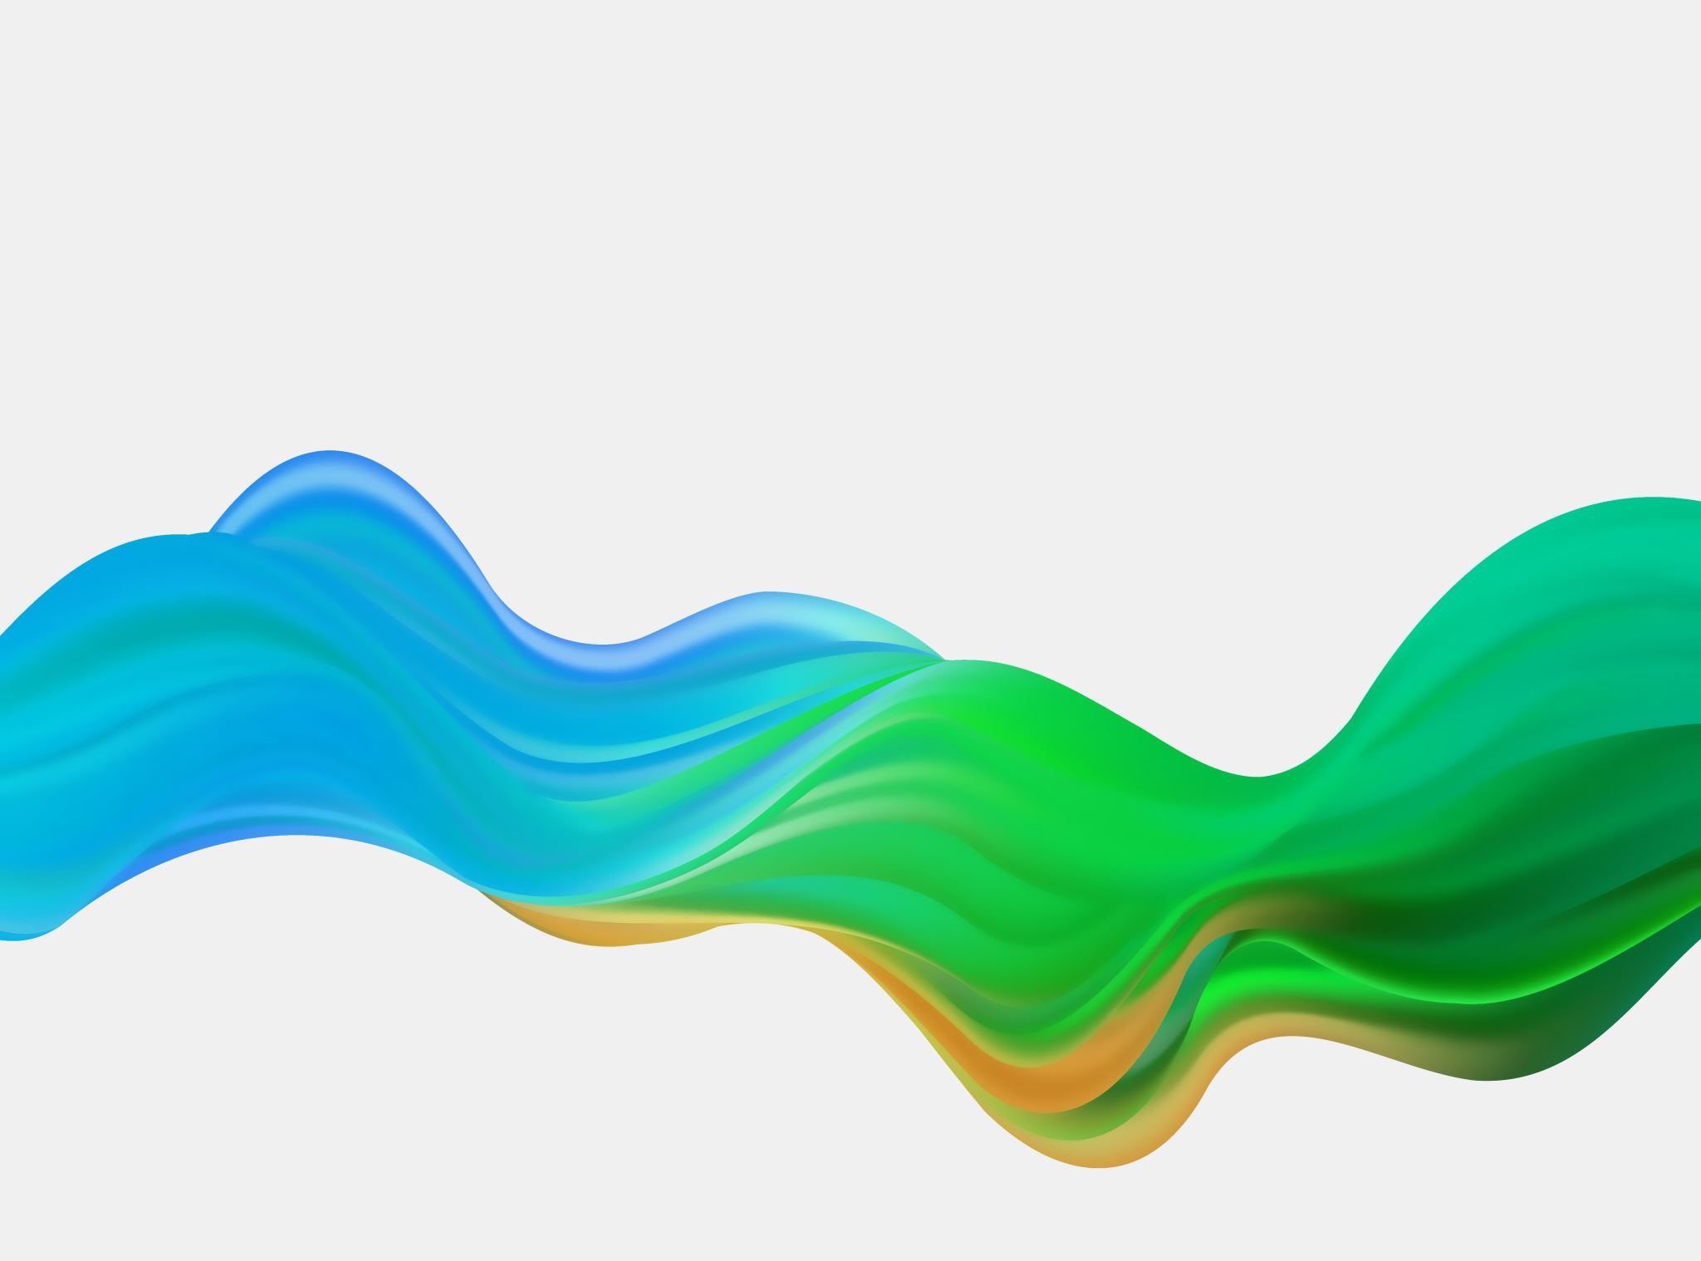
Air canvas
Prepared by:-
Naindeep Kaur (17CSU221
Namita (18CSU146)
Rohit (18CSU179)
Tanvi (18CSU249)

Slide 2
What is an Air Canvas ?
On an Air Canvas we can draw anything on it.
We can draw anything by just capturing the motion of a colored marker with a camera.
In an air canvas a colored object at the tip of the finger is used as the marker.

Slide 3
Motivation for the idea for Air Canvas
A need for a dustless class room for the students .
Affordable , unlike huge large screens with same fuctionality of teaching on them like a T.V.
A finger be tracked, but that too at a initial level without deep learning.
Hence it was OpenCV which came to the rescue for these computer vision projects.

Slide 4
Features of the Air Canvas
It can track any specific colored pointer .
User can draw in four different colors and even change them without any husstle.
Able to rub the board with a single location at the top of the screen.
No need to touch the computer once the program is run.

Slide 5

Theory
Here Color Detection and tracking are used in order to achieve the objective.
The color marker is detected and a mask is produced.
It includes morphological operations on the mask produced which are Erosion and Dilation.
Erosion reduces the impurities present in the mask and dilation further restores the eroded main mask.

Slide 6
Libraries Used
Python3
NumPy
OpenCV

Slide 7
Algorithm
Start reading the frames and convert the captured frames to HSV color space (Easy for color detection).
Prepare the canvas frame and put the respective ink buttons on it.
Adjust the track bar values for finding the mask of the colored marker.
Preprocess the mask with morphological operations (Eroding and dilation).
Detect the contours, find the center coordinates of largest contour and keep storing them in the array for successive frames (Arrays for drawing points on canvas).
Finally draw the points stored in an array on the frames and canvas.

Slide 8
Working
Colour Tracking of Object at fingertip
Contour Detection of the Mask of Color Object
Drawing the Line using the position of Contour
Drawing the points

Slide 9
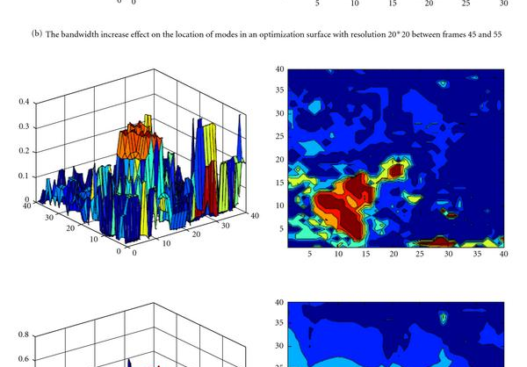
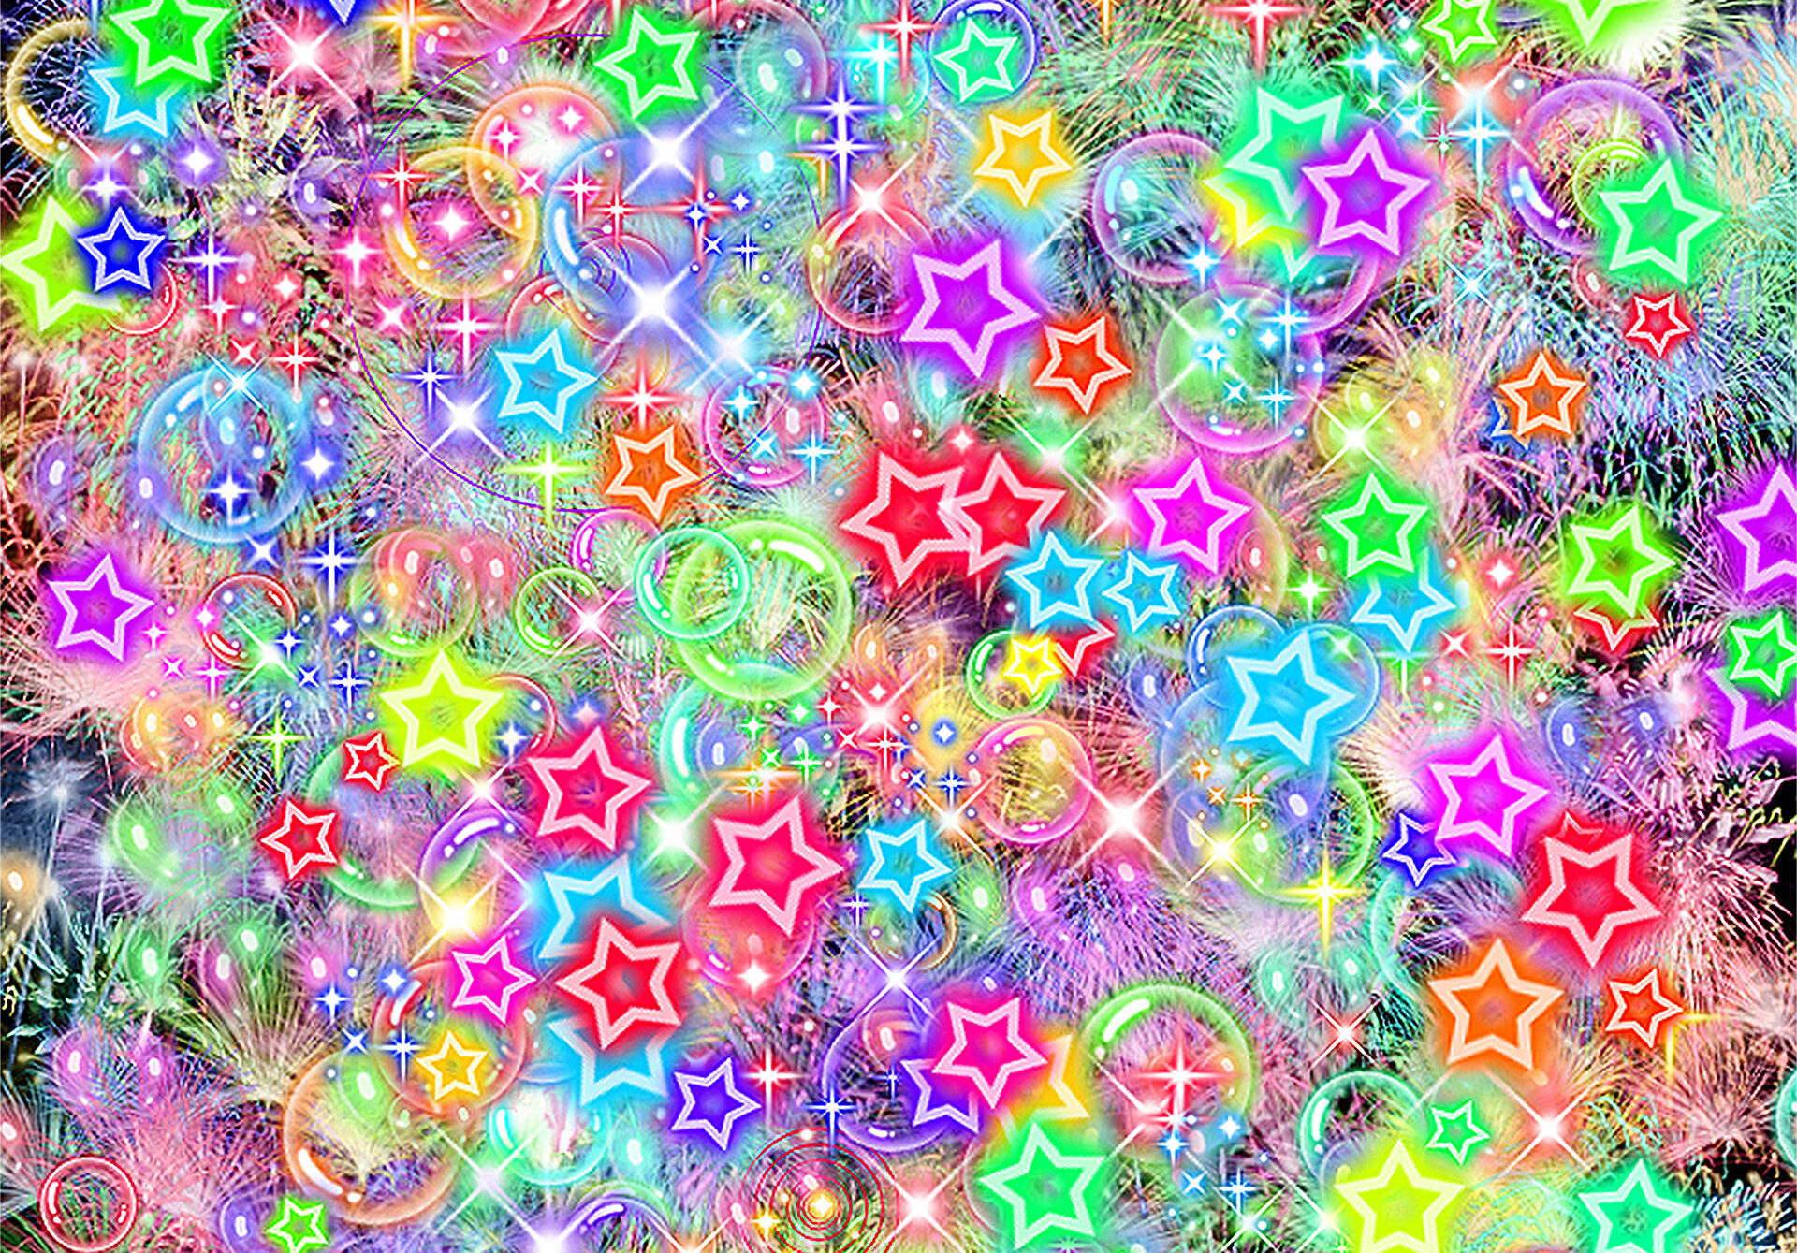
Colour Tracking of Object at fingertip
This Photo by Unknown author is licensed under CC BY.
This Photo by Unknown author is licensed under CC BY.

Slide 10
The incoming image from the webcam is to be converted to the HSV color space for detecting the colored object at the tip of finger. The code converts the incoming image to the HSV space, which is very suitable and perfect color space for Color tracking.
We have made Trackbars to arrange the HSV values to the required range of color of the colored object that are placed at our finger. The various HUE and other ranges of different colors can be seen there
Now, When the trackbars are setup, we will get the realtime value from the trackbars and create range. This range is a numpy structure which is used to be passed in the function cv2.inrange( ) This function returns the Mask on the colored object. This Mask is a black and white image with white pixels at the position of the desired color.

Slide 11

Contour Detection of the Mask of Color Object
This Photo by Unknown author is licensed under CC BY-NC-ND.

Slide 12
After detecting the Mask in Air Canvas, Now is the time to locate its center position for drawing the Line. Here, We have performed some morphological operations on the Mask, to make it free of impurities and to detect contour easily.

Slide 13
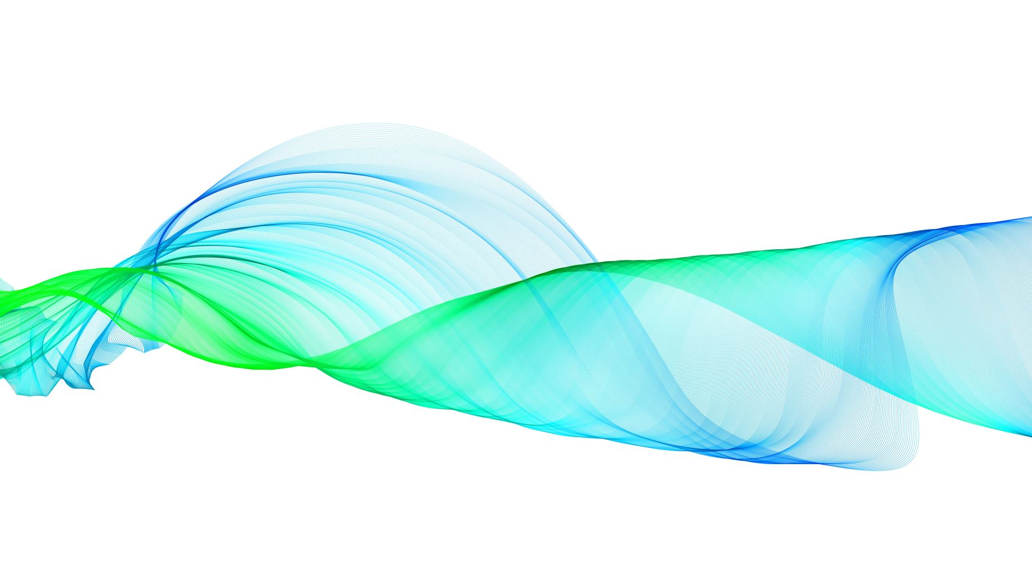
Drawing the Line using the position of Contour

Slide 14
We will form a python deque (A data Structure). The deque will store the position of the contour on each successive frame and we will use these stored points to make a line using OpenCV drawing functions.
Now, we will use the position of the contour to make decision, if we want to click on a button or we want to draw on the sheet. We have arranged some of the buttons on the top of Canvas, if the pointer comes into their area, we will trigger their method. We have four buttons on the canvas, drawn using OpenCV.
Firstly Make Four deques, for four distinct colors of the project :

Slide 15
Clear : Which clears the screen by emptying the deques.
Red : Changes the marker to red color using color array.
Green : Changes the marker to Green color using color array.
Yellow : Changes the marker to Yellow color using color array.
Blue : Changes the marker to Blue color using color array.
Also, to avoid drawing when contour is not present, We will Put a else condition which will capture that instant.

Slide 16

Drawing the points

Slide 17
Now we will draw all the points on the positions stored in the deques, with respective colour

Slide 18
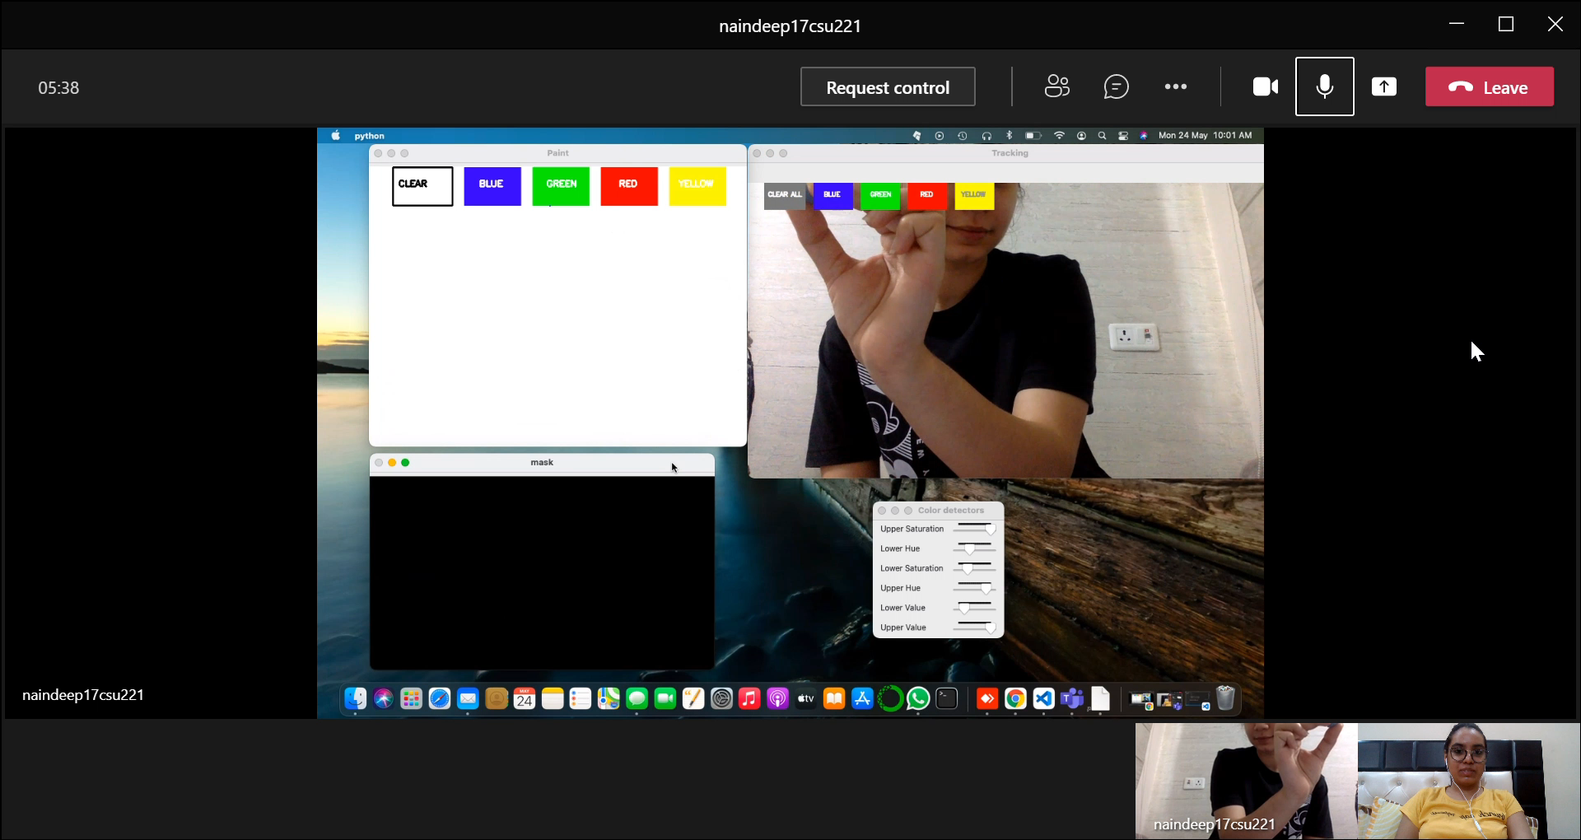

Slide 19

THANKYOU

